Slide 1
IIT Project
Face mask Detection
Abijith Pradeep

Slide 2
Objective
To detect the faces given a dataset and predict the bounding box of the face and tell which category it belongs to.

Slide 3
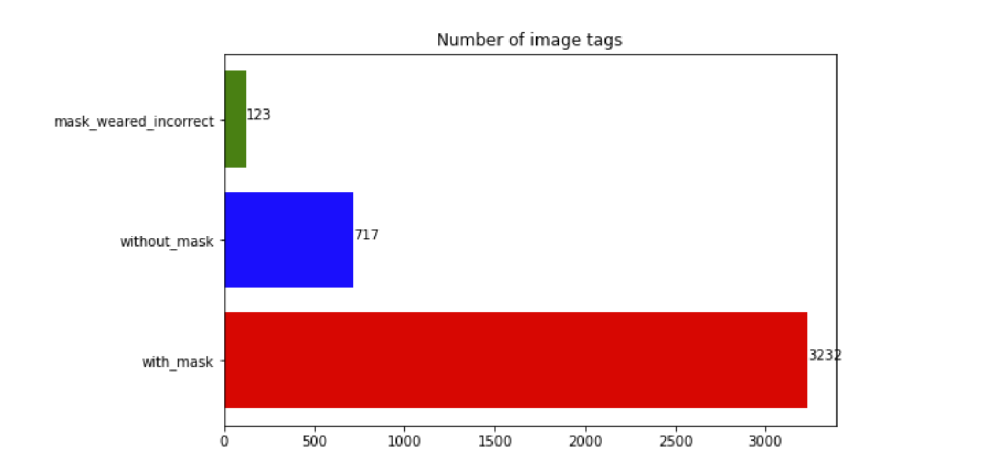
Dataset
Face –mask –detection from Kaggle was used.
Total of images: 4072
Masked: 3232, No mask: 717, Mask incorrectly worn: 123

Slide 4
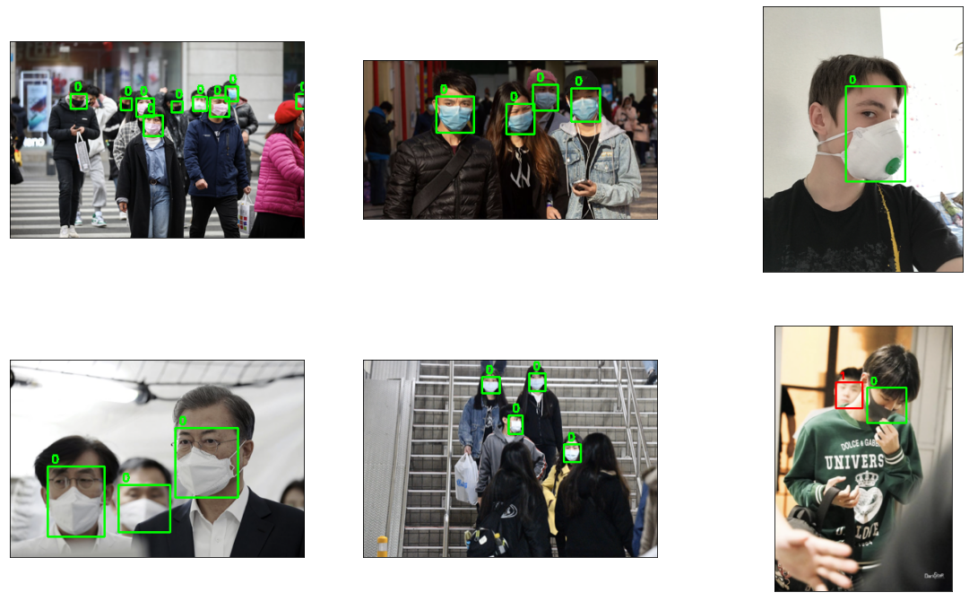
Sample data

Slide 5
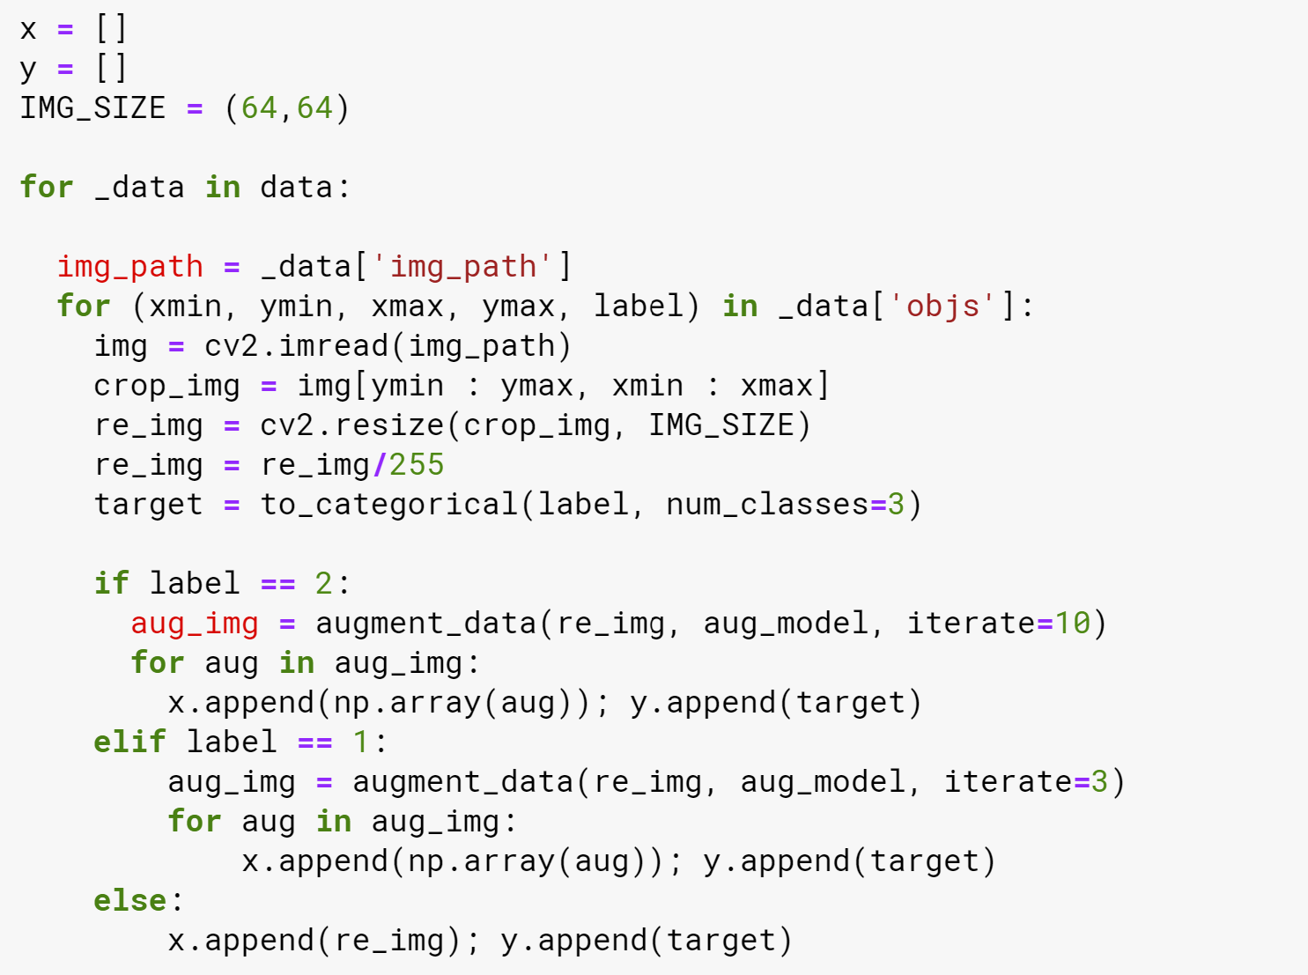
Splitting Data

Slide 6
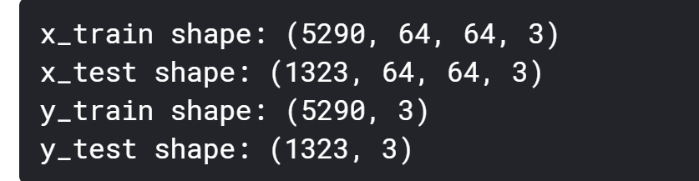
Train Test Split

Slide 7
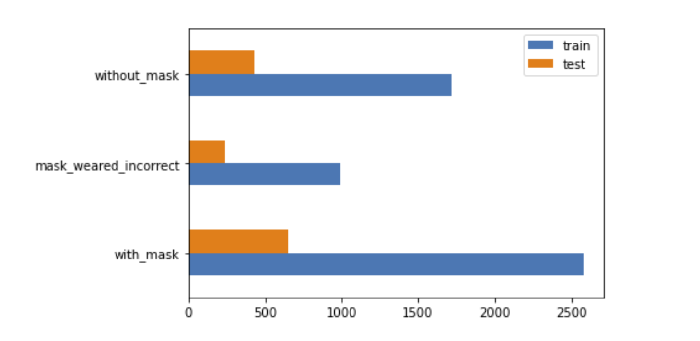
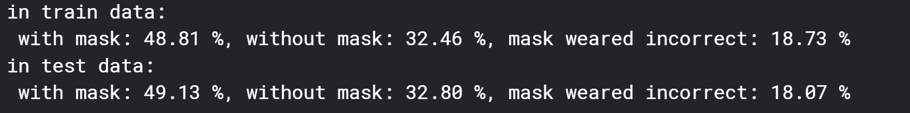
Train vs Test: Category count

Slide 8
Model
Simple Sequential Model used.
Optimizer: Adam, Loss: Categorical crossentropy, Metrics: Accuracy
Layers: Conv2D, Maxpooling2D, Dropout, Flatten and Dense

Slide 9
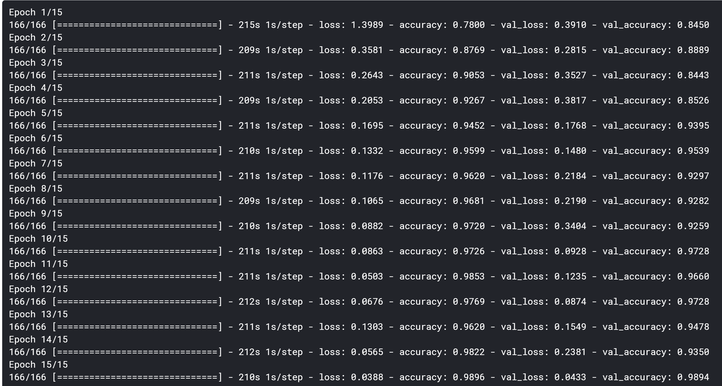
Model fitting

Slide 10
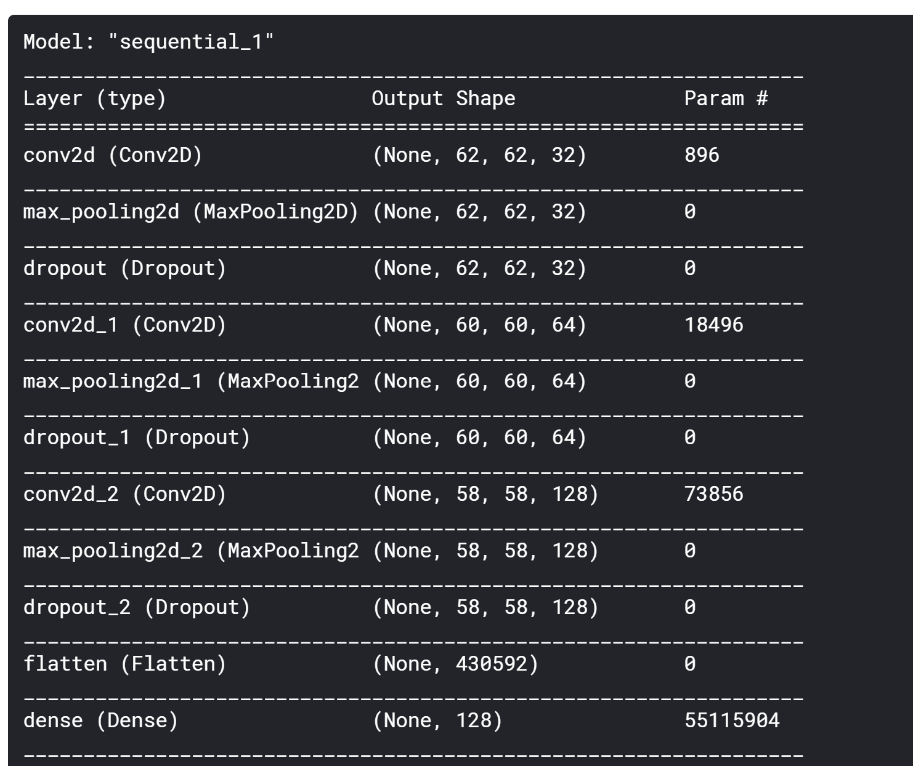
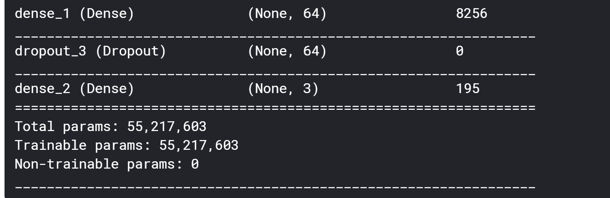
Model summary

Slide 11
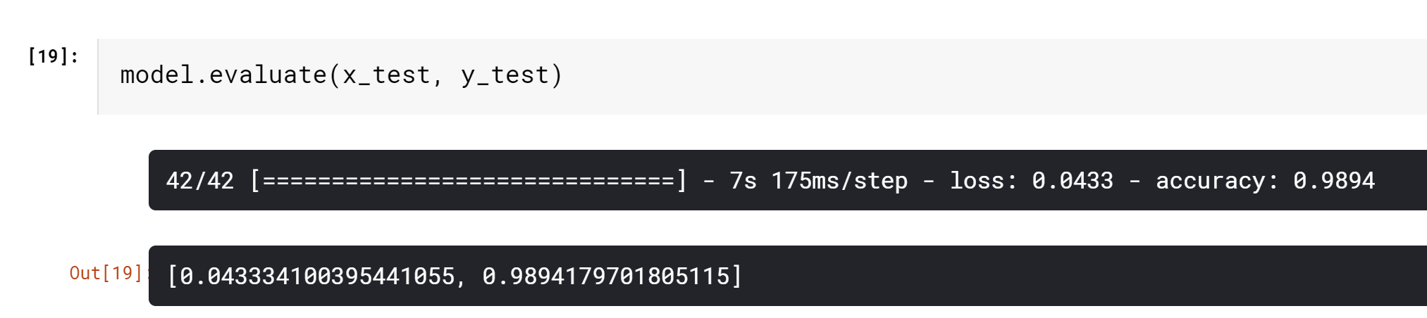
Evaluation on test data

Slide 12
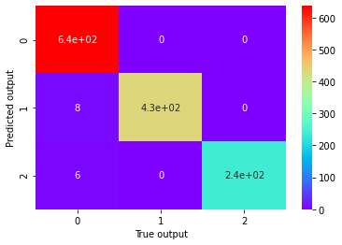
Confusion matrix

Slide 13
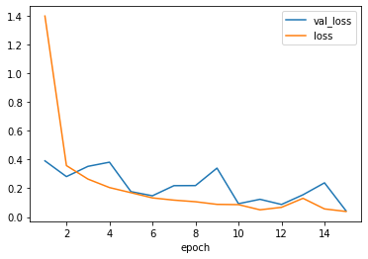
Loss Plot

Slide 14
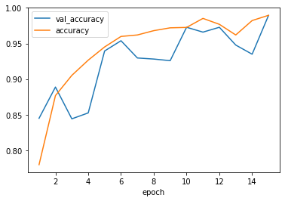
Accuracy plot

Slide 15
Improvising
Since the detector now predicts and identifies the type of class the person belongs, we can give it an organizational access.
In other words, get this detector at the entrance of factory/company to check if the employees are coming with correct way, i.e. mask present and covering the mouth and nose.
It won’t allow entry if the person isn’t wearing the mask incorrectly.
Since it takes some time to train the model, we can save this model and use it later on for other purposes.

